Slide 1

Crude Oil
Overview & Changing Trends
IEPR Commissioner Workshop − Trends in
Crude Oil Market and Transportation
July 20, 2015
Gordon Schremp
Energy Assessments Division
California Energy Commission
Gordon.schremp@energy.ca.gov
California Energy Commission

Slide 2
Workshop Purpose
Follow-up to IEPR workshop in Berkeley on June 25, 2014
Significant changes in crude oil markets and prices
Progress of West Coast crude-by-rail projects slowed by opposition
Safety concerns of transporting hazardous materials have spurred additional state, federal, and international actions
California Energy Commission

Slide 3
Topics
California Overview
  Refineries, oil production, other sources & infrastructure
United States Overview
  Rising oil production & decreasing imports & increasing transportation of crude oil by rail tank car
Global Overview
  Rising excess supply & price decline
Crude-by-Rail (CBR)
  Increasing transportation of crude oil by rail tank car
  Status of CBR projects – West Coast
Agency Roles & Responsibilities
California Energy Commission

Slide 4
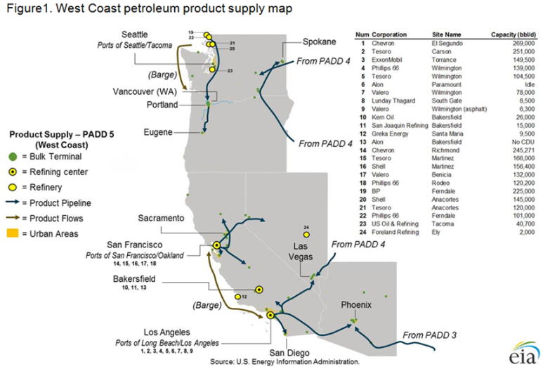
California Overview
California Energy Commission

Slide 5
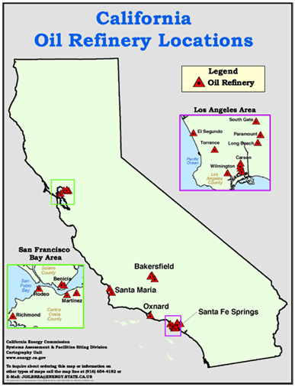
California Refineries
  3 primary refinery locations
  12 refineries produce transportation fuels that meet California standards
  8 smaller refineries produce asphalt and other petroleum products
  California refineries provide majority of transportation fuel to neighboring states
  Process over 1.6 million barrels per day of crude oil
California Energy Commission

Slide 6
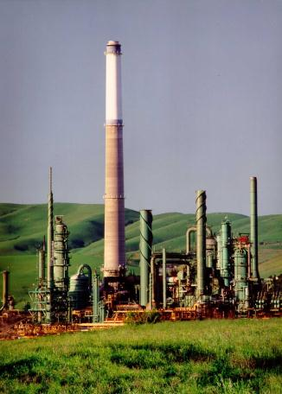
California Refineries
  Refineries are a primary hub of logistical activity
    Raw materials imported & finished products shipped
  Crude oil receipts during 2014 received by
    Marine vessels (foreign) - 787.1 TBD
    Marine vessels (Alaska) – 190.5 TBD
    California source via pipelines – 664.8 TBD
    Rail/truck – 15.7 TBD
  Process units operate continuously at or near maximum capacity, except during periods of planned maintenance or unplanned outages
Valero Benicia refinery
TBD = Thousands of Barrels Per Day
California Energy Commission

Slide 7
California Energy Commission

Slide 8
Increased number of producing wells has had marginal impact on average level of output per well per day.
California Energy Commission

Slide 9
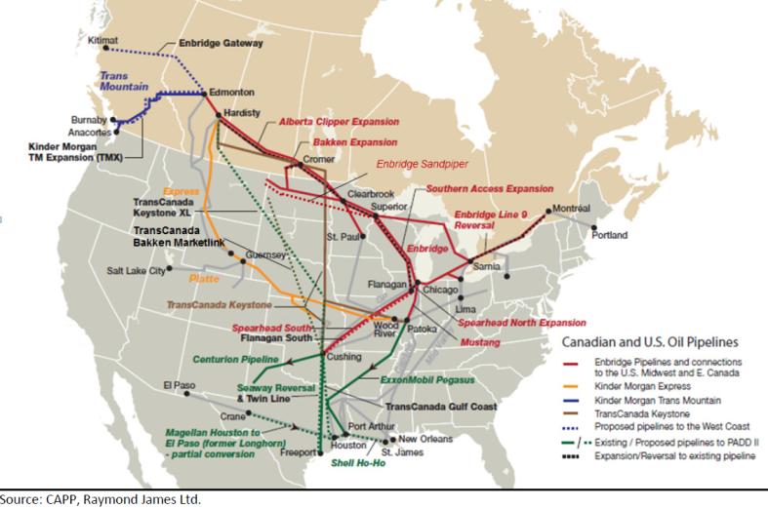
Crude Oil Pipeline Projects
No crude oil pipelines into California…one project being examined.
California Energy Commission

Slide 10
Crude Oil Sources for CA Refineries
Declining CA & Alaska sources replaced by additional foreign imports.
California Energy Commission

Slide 11
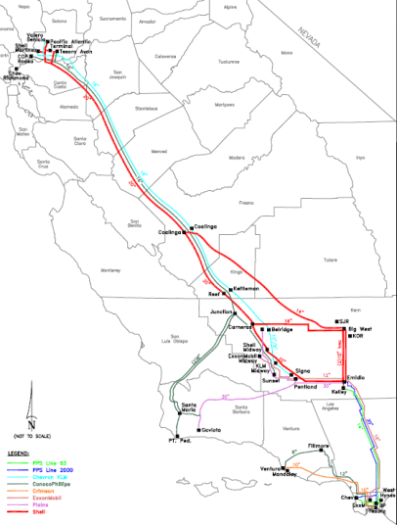
Pipeline Access Important
  Northern California refineries processed 754.8 thousand barrels per day of crude oil during 2014
    261.6 TBD pipeline shipments
    35 percent of crude oil received
  State Fire Marshal’s Office
    Intrastate pipeline oversight
  Increased crude-by-rail likely to back out marine receipts of similar quality
  Rail capability increases flexibility to enhance supply options & reduces risk of crude oil receipt curtailment
California Energy Commission

Slide 12
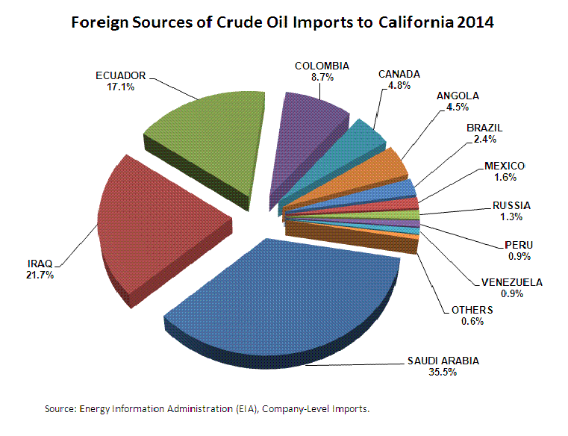
California Energy Commission

Slide 13
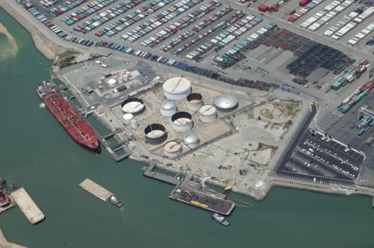
Marine Terminals Receive Imports
  Marine facilities are located in sheltered harbors with adequate draught to accommodate typical sizes of petroleum product tankers and crude oil vessels
  State Lands Commission has oversight of marine terminal building standards – also track loading and discharges
  Most refiners operate a
  proprietary dock
  Absent growth in crude-by-rail imports, volume of imported oil and utilization of existing marine oil terminals could increase over the near-term
California Energy Commission

Slide 14
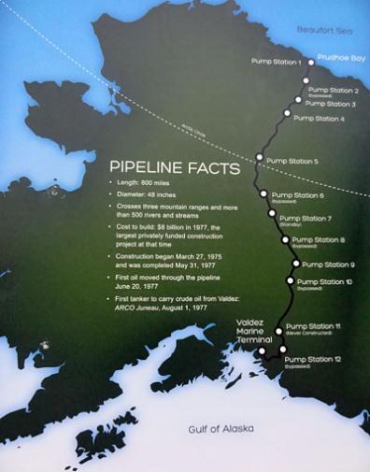
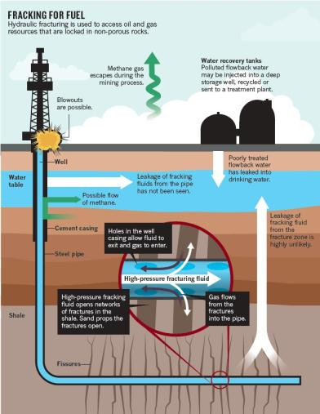
United States Overview
California Energy Commission

Slide 15
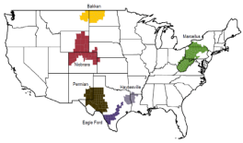
U.S. Tight Oil Production – Jan. ’07-June ‘15
3 U.S. fields each exceed 1 MM barrels per day
Combined 4.904 MM BPD
California Energy Commission

Slide 16
U.S. Crude Oil Production – Jan. ‘81-Apr. ‘15
California Energy Commission

Slide 17
California output nearly unchanged after more than five years.
California Energy Commission

Slide 18
U.S. Imports of Crude Oil Decline
2014 oil imports 2.79 million BPD lower than 2005 peak of 10.13 million BPD.
California Energy Commission

Slide 19


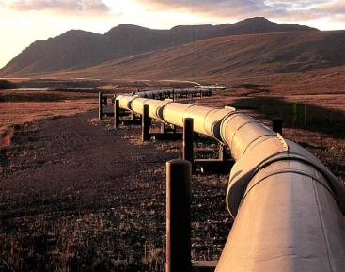
Global Overview
California Energy Commission

Slide 20

Global Demand Growth Outlook
Europe
FSU
North America
Asia
Middle East
Latin America
Africa
Source: International Energy Agency (IEA) – Oil Market Report – June 11, 2015
2015 outlook 93.97 MB/D vs. 92.57 MB/D in 2014 (up 1.51%).
California Energy Commission

Slide 21
Global Crude Oil Production Change
2014 vs. 2008
U.S. increase more than 3 times greater than the other top 20 countries combined – 4,860 vs. 1,522 thousands of barrels per day.
California Energy Commission

Slide 22
Global Crude Supply Imbalance
Excess global crude oil supplies increase into 2015.
California Energy Commission

Slide 23
Steep Price Decline
Crude oil prices peaked during June of 2014
  June 19, 2014 – Brent - $115.06 per barrel
  June 20, 2014 – Alaska North Slope (ANS) - $114.51 per barrel
  June 20, 2014 – WTI - $107.95 per barrel
  June 24, 2014 – San Joaquin Valley (SJV) - $99.65 per barrel
Prices dropped at least 50 percent within 7 months
  Brent down 59.5 percent to $46.59 on 1/13/15
  ANS down 60.6 percent to $45.10 on 1/28/15
  WTI down 59.2 percent to $44.08 on 1/28/15
  SJV down 68.7 percent to $31.14 on 1/21/15
Prices have since rebounded a bit before easing back down
California Energy Commission

Slide 24
Daily Brent Crude Oil Prices (2011 – 7/17/15)
Crude oil prices were remarkably stable between 2011 and June of 2014
Source: Energy Information Administration & OPIS.
California Energy Commission

Slide 25
Crude Oil Prices – West Coast, Brent & WTI
Following a late spring rebound, prices now softening from continued global supply surplus.
California Energy Commission

Slide 26
Crude Oil – Export Restrictions
  Domestically‐produced crude oil exports to foreign destinations allowed under specific "license exceptions" identified under federal statute - primary exceptions include:
    Alaska crude oil shipped on the Trans‐Alaska Pipeline System (TAPS) and exported via a Jones Act vessel directly from Valdez Harbor
    California heavy crude oil production with API gravity of 20.0 degrees or lower, limit of no more than 25,000 barrels per day
      First export license for California heavy crude oil was granted on December 9, 1991 – no heavy crude oil exports for several years
    Exports of domestic crude oil to Canada for processing by Canadian refineries
    Exports in connection with refining or exchange of Strategic Petroleum Reserve crude oil
  Companies can also apply to the federal Bureau of Industry and Security (BIS) for an export license that basically requires Presidential approval
Recent export licenses for “processed” condensate approved.
California Energy Commission

Slide 27
Oil Rig Deployment Declines with Price
Number of rigs deployed specifically for U.S. oil drilling 60.3 percent lower than the peak level on October 10, 2014
Y-T-D down 56.9 percent
Gradual impact on oil production likely to continue manifesting itself over the next several months
Biggest drops in Permian (-319), Williston (-125), and Eagle Ford (-125) basins
Source: Baker Hughes data – through July 17, 2015.
California Energy Commission

Slide 28
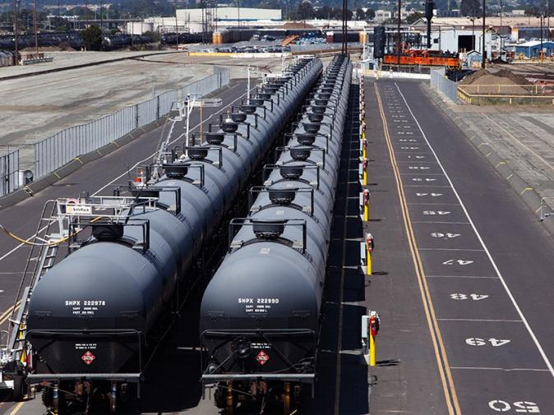
Crude-by-Rail (CBR)
Source: KinderMorgan rail yard in Richmond – Chris Jordan-Bloch, Earthjustice
California Energy Commission

Slide 29
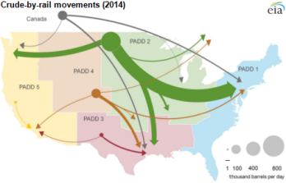
U.S. Crude-by-Rail Transportation
California Energy Commission

Slide 30

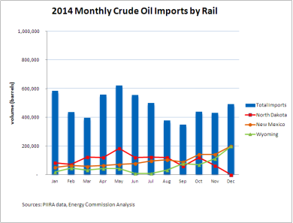
California Crude-by-Rail Imports
  2013 CBR imports – 6.3 MM Barrels
  2014 CBR imports – 5.7 MM Barrels
    Average of 15,720 barrels/day
    Approximately 8,700 rail tank cars
    Average of 660 barrels/rail tank car
California Energy Commission

Slide 31
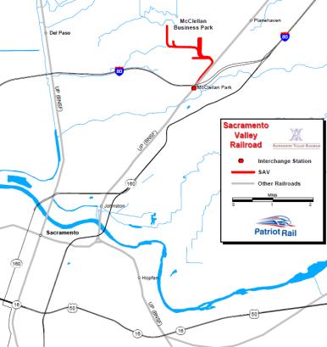
Northern California – CBR Activity
  One location currently receiving CBR deliveries
    Kinder Morgan – Richmond Rail Facility
    Facility is permitted to receive an average maximum of 16,000 barrels per day of crude oil via rail tank car
    Crude oil transferred to trucks
  Kinder Morgan facility can receive crude oil unit trains
  SAV Patriot in McClellan had permit rescinded and operations ceased in early November 2014
  Current permit capacity of 58,000 barrels per day for state, excluding Plains All American in Taft
Source: Patriot Rail
California Energy Commission

Slide 32
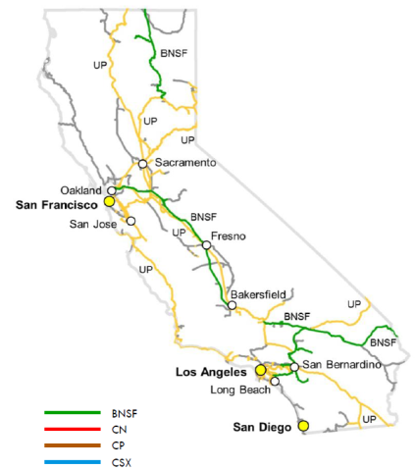

Rail Routes Into and Within California
CBR Routing Information - California
Energy Commission does not track routes of CBR deliveries – only source states/provinces, destinations within California, and volumes
Counties transited by trains carrying more than 1 million gallons of Bakken crude oil are reported by Class 1 railroads to OES
Crude oil from Canada, North Dakota and Wyoming will likely traverse the state from north to south
Crude oil from Colorado, New Mexico and Texas will likely traverse the state from east to west
California Energy Commission

Slide 33
CBR numbers for Y-T-D 2015 down 46.2 percent compared 2014 (761,514 barrels versus 1,415,605 barrels).
California Energy Commission

Slide 34
Crude Discounts vs. California CBR Imports
California Energy Commission

Slide 35
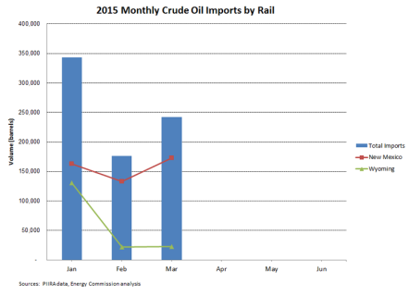
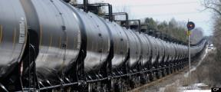
California CBR Imports Expected to Grow
  One CBR project operational
    Plains All American – near Bakersfield
  One CBR project received permits
    Alon USA - Bakersfield
  Two CBR projects seeking permits
    Valero & Phillips 66
  One CBR project modified
    WesPac in Pittsburg
  CBR imports during 2015
    Could approach 4 percent if Plains All American facility operates at capacity
  Could grow up to 22 19 percent by 2016 2017 assuming:
    Permits issued, customers signed up, financing approved, construction completed & facilities operated at capacity
California Energy Commission

Slide 36
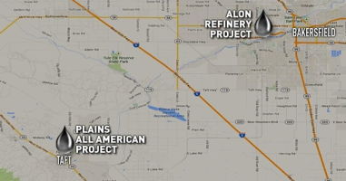
Crude-by-Rail Projects – Bakersfield
Alon Crude Flexibility Project - Approved
Alon – Bakersfield Refinery
2 unit trains per day
150,000 BPD offloading capacity
Will be able to receive heavy crude oil
Oil tankage connected to main crude oil trunk lines – transfer to other refineries
Kern County Board of Supervisors approved permits for the project on September 9, 2014
Contract awarded for initial engineering work – May 2015
Construction will take 9 months, could be complete by 2016 assuming customers sign long-term agreements and financing is approved
Plains All American – Bakersfield Crude Terminal – Operational
Up to 65,000 BPD
Connection to additional crude oil line via new six-mile pipeline
Initial delivery during November 2014
Poor rail economics have limited deliveries
Litigation underway regarding permit
Source: KernGoldenEmpire.com
California Energy Commission

Slide 37
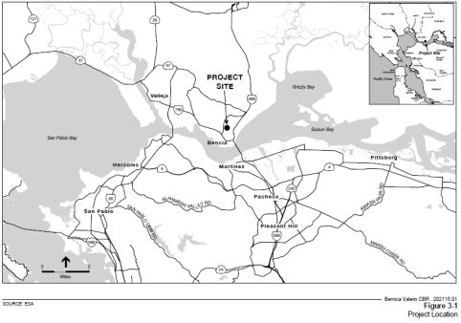
Crude-by-Rail Projects – Northern California
  Valero – Benicia Crude Oil By Rail Project – Permit Review
    Benicia refinery
    Up to 70,000 BPD
    Construction will take 6 months
    Could be operational by 2016
    Recirculated Draft Environmental Impact Report (RDEIR) will be released August 31, 2015
    45-day comment period
    Lead agency – City of Benicia
    http://www.ci.benicia.ca.us/index.asp?Type=B_BASIC&SEC={FDE9A332-542E-44C1-BBD0-A94C288675FD}
California Energy Commission

Slide 38
Crude-by-Rail Projects – Northern California
WesPac Energy Project – Pittsburg – Revised Permit Review
Will no longer include rail access
Includes marine terminal for receipt and loading – average of 192,000 BPD
Connection to KLM pipeline – access to Valero, Shell, Tesoro & Phillips 66 refineries
Connection to idle San Pablo Bay Pipeline – access to Shell, Tesoro & Phillips 66 refineries
Could be operational by 2017
Notice of Preparation (NOP) of a Second Recirculated Draft EIR is now available for a 30-day public review – comments due July 31, 2015
Lead agency – City of Pittsburg
http://www.ci.pittsburg.ca.us/index.aspx?page=700
California Energy Commission

Slide 39
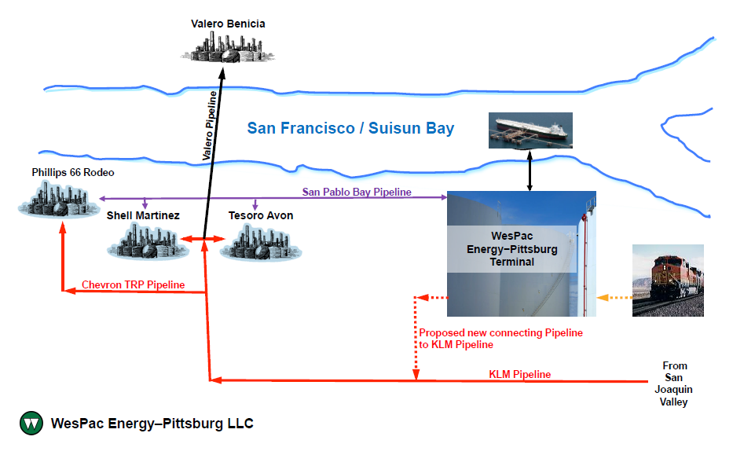
WesPac Project – Refinery Connections
Project will no longer include rail access.
California Energy Commission

Slide 40
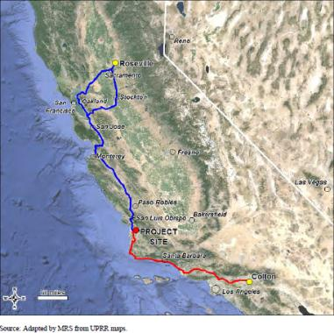
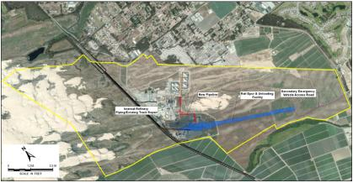
Crude-by-Rail Projects – Central California
Phillips 66 – Santa Maria Refinery – Permit Review
Average of 37,142 BPD
Construction 9 to 10 months to complete
Could be operational by 2016
Planning and Building Department is currently working toward releasing a Final Environmental Impact Report
Lead agency – County of San Luis Obispo
http://www.slocounty.ca.gov/planning/environmental/EnvironmentalNotices/Phillips_66_Company_Rail_Spur_Extension_Project.htm
Source: Phillips 66 Draft EIR – October 2014
California Energy Commission

Slide 41
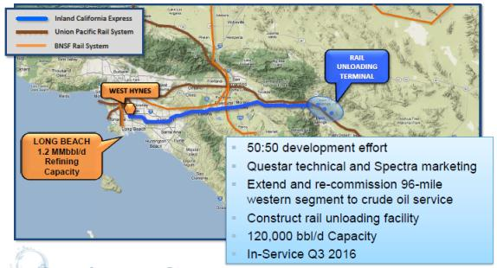
Crude-by-Rail Projects – Planned
Two Projects not included in CBR projection by Energy Commission
Targa – Port of Stockton – Planned
Up to 65,000 BPD
Receive rail, load barges
Questar Project - Planned
East of Desert Hot Springs
Nearly 2 unit trains per day
120,000 BPD offloading capacity
Connection to Los Angeles basin crude oil pipeline network
Company is still performing an engineering analysis
Could be operational by late 2017
Source: Questar Pipeline customer meeting, March 2014
California Energy Commission

Slide 42
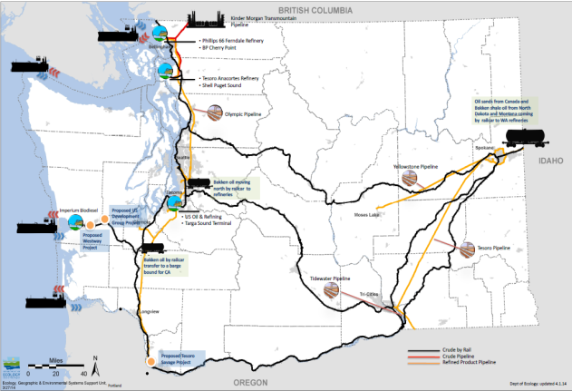
Washington CBR Projects
California Energy Commission

Slide 43
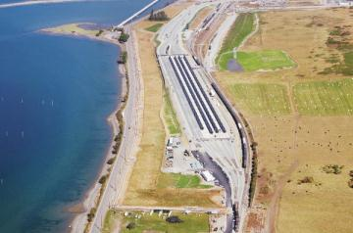
Active CBR Facilities – Pacific Northwest
Tesoro – Anacortes Refinery – Operational
Up to 50,000 BPD
Operational September 2012
BP – Cherry Point Refinery – Operational
Up to 60,000 BPD
Operational December 2013
Global Partners – Clatskanie, OR – Operational
Originally up to 28,600 BPD
8/19/14 - permit revised to 120,000 BPD
Phillips 66 – Ferndale Refinery – Operational
Up to 20,000 BPD, mixed freight cars
Permits received for expansion to 40,000 BPD in 2014
U.S. Oil and Refining – Tacoma Refinery – Operational
Up to 6,900 BPD
Seeking permits to expand capacity to 48,000 BPD
CBR off-loading capacity up to 280,900 BPD
Source: Skagit Valley Herald
California Energy Commission

Slide 44
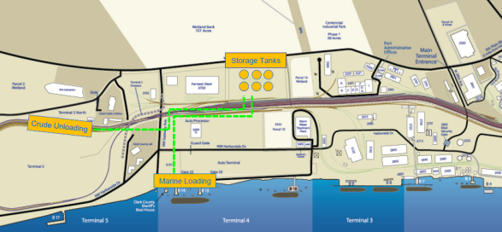
CBR Projects – Pacific Northwest
Tesoro – Savages, Port of Vancouver Project – Permit Review
Rail receipts of unit trains & loading of marine vessels
Initial capacity up to 120,000 BPD
Tesoro will have off-take rights to 60,000 BPD
Expansion capability of up to 360,000 BPD
Revised draft EIS to be released late November 2015
Lead agency - Energy Facility Site Evaluation Council
http://www.efsec.wa.gov/Tesoro-Savage.shtml
California Energy Commission

Slide 45
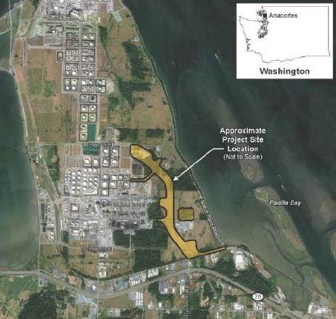
CBR Projects – Pacific Northwest
Shell – Anacortes Refinery Project – Permit Review
Rail receipts of unit trains
Capacity up to 62,000 BPD
Draft EIS to be developed after Shell appeal to obtain a Mitigated Determination of Non-Significance was denied in May 2015
Lead agency – Skagit County Planning & Development Services
Possible initial start-up during late 2016
http://www.skagitcounty.net/Departments/PlanningAndPermit/shellpermit.htm
California Energy Commission

Slide 46
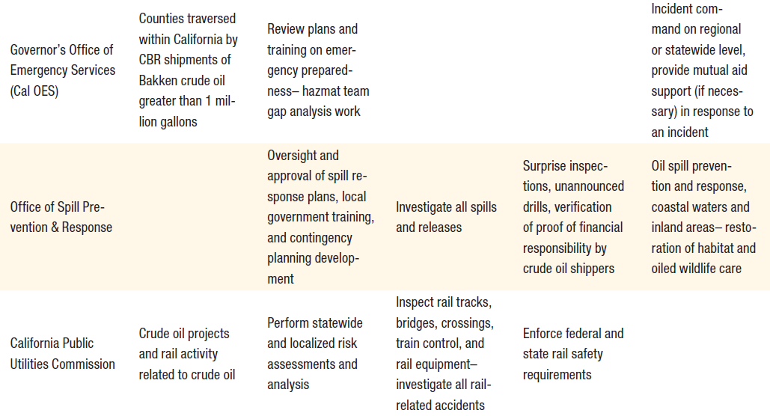
Agency Roles & Responsibilities
Source: California Energy Commission
California Energy Commission

Slide 47
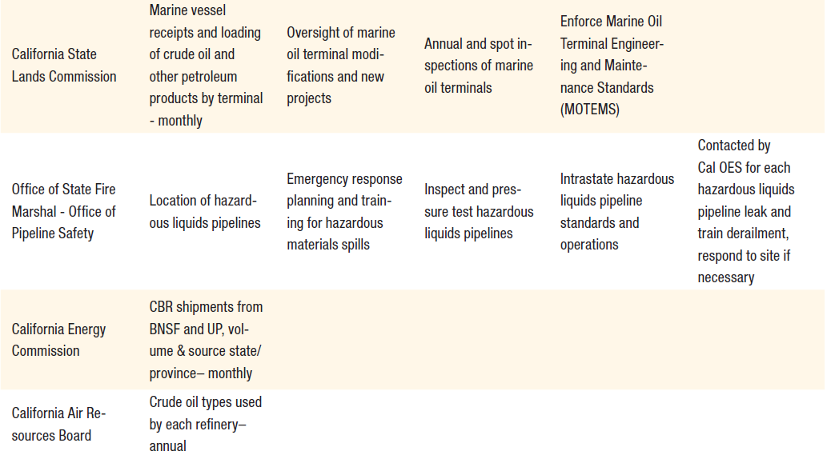
Agency Roles & Responsibilities
Source: California Energy Commission
California Energy Commission

Slide 48
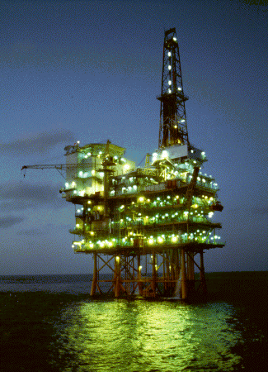
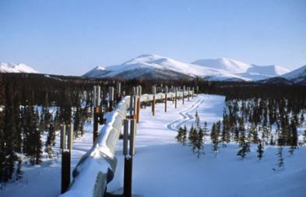
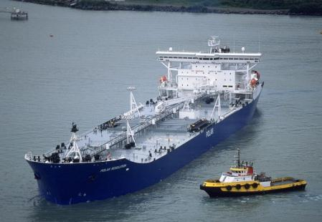
Additional Q & A
California Energy Commission

