Slide 1
Oil by Rail Safety in California Report Interagency Rail Safety Working Group June 10, 2014
CA Oil by Rail Risk and Response Map
High Hazard Areas,
Known Geologic Faults,
Sensitive Species/Habitat Occurrences,
HazMat Team Locations

Slide 2
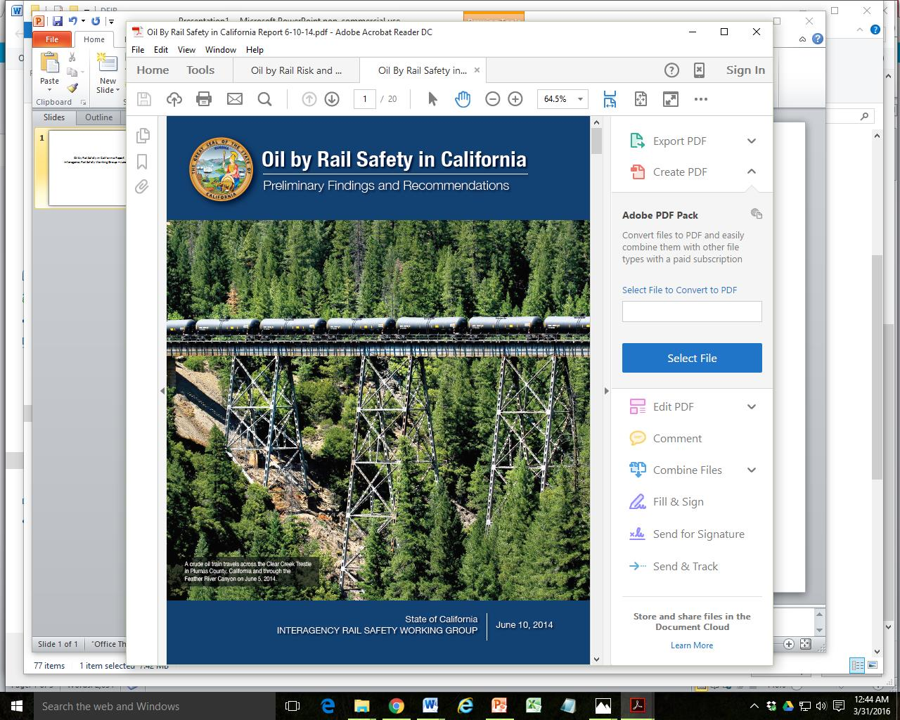
Notes:
The Interagency Rail Safety Working Group for the State of California submitted this report on June 10, 2014. It was timed for the release of the Benicia draft EIR and was submitted when that draft came out somewhat later that summer.

Slide 3
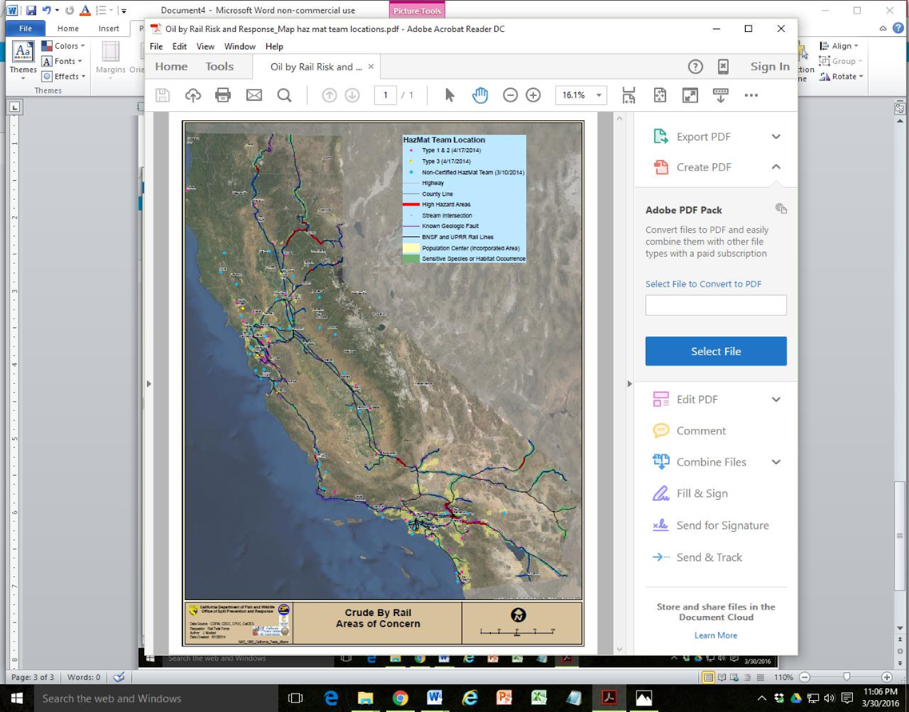

Slide 4
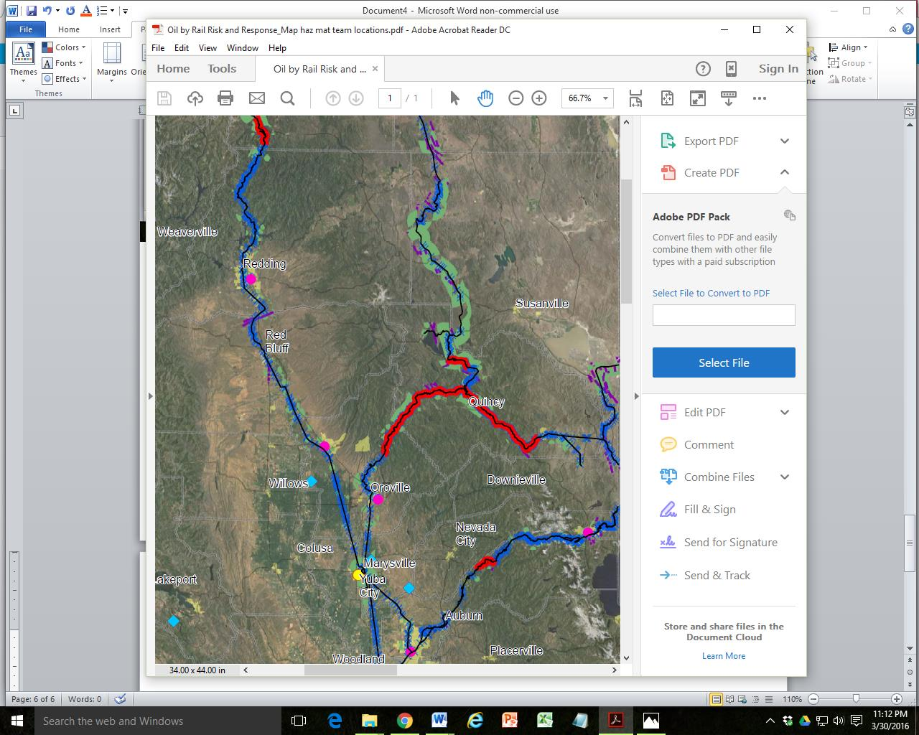

Slide 5
All three of the northern routes into CA have stretches of high hazard rail.
Oregon through Dunsmuir and Redding to Roseville. An herbicide spill from a derailment near Dunsmuir killed everything for 20 miles of the Sacramento River; it took a decade to recover.
Feather River Canyon, either from the north or from the east. A grain train derailed Nov. 2014. Cars breached as they rolled down the embankment and spilled corn into the river.
Donner Pass over the Sierra Nevada Mountains requires 5 engines.

Slide 6
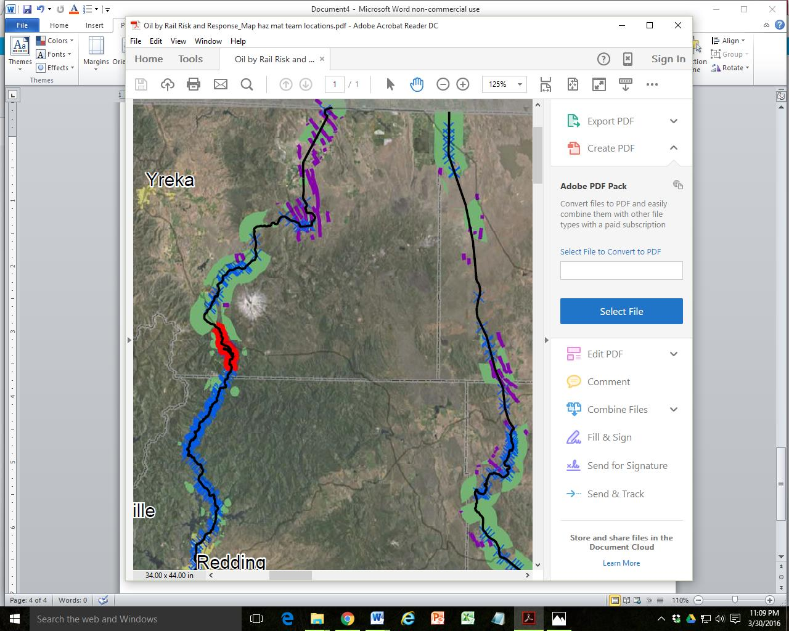

Slide 7
Zoom in on the Dunsmuir Area
Bright red = high hazard rail area
Purple lines = known geologic faults
Green = Sensitive Species or Habitat Occurrences
Blue = water, rivers,
Blue x’s = river/creek crossings

Slide 8
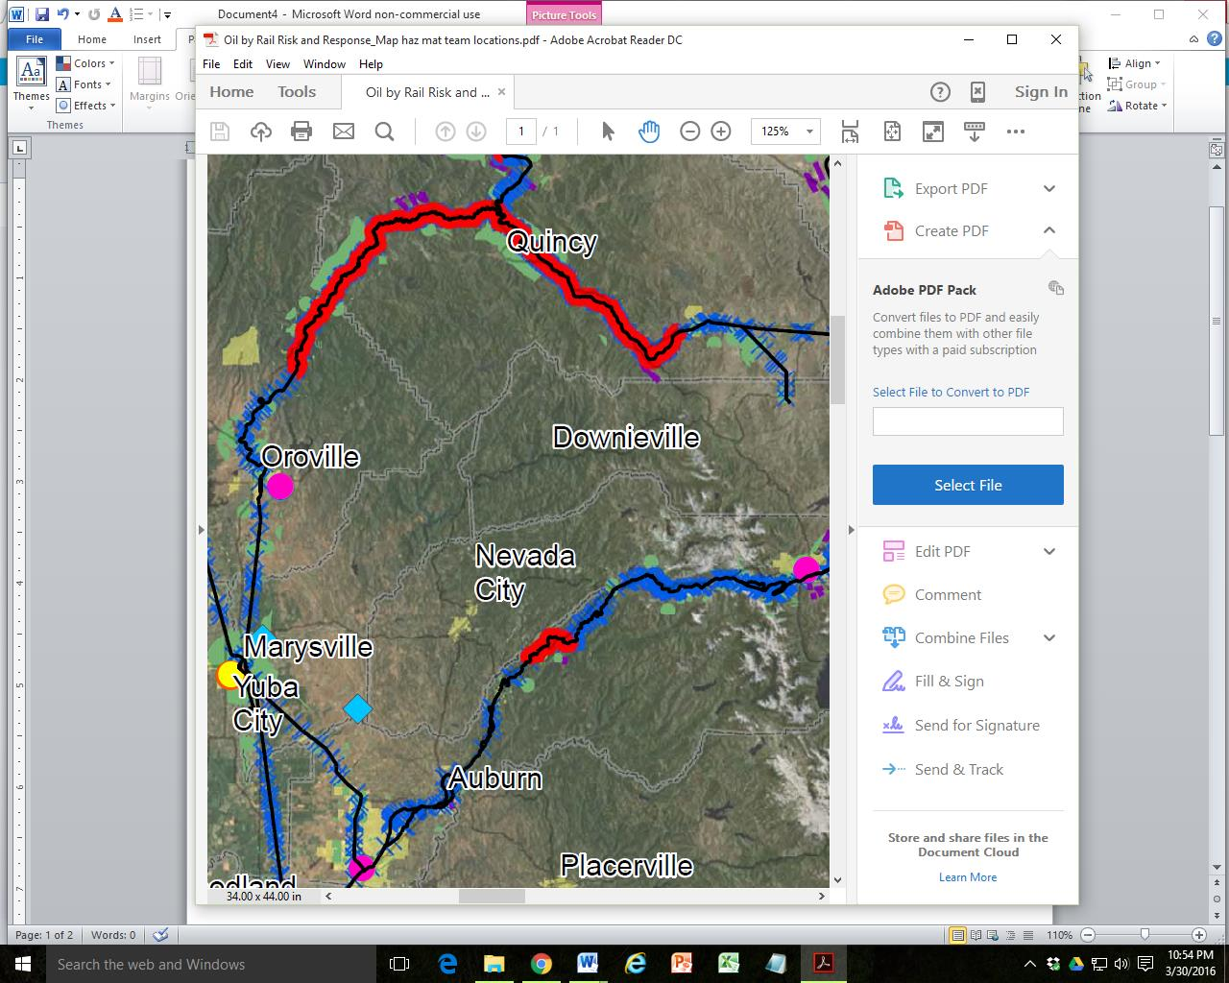

Slide 9
Zoom in on Feather River Canyon and Donner Pass
Pink dot = Type 1 & 2 teams with the most training;
yellow dot = Type 3 teams to lend assistance
Blue squares = non-certified teams

Slide 10
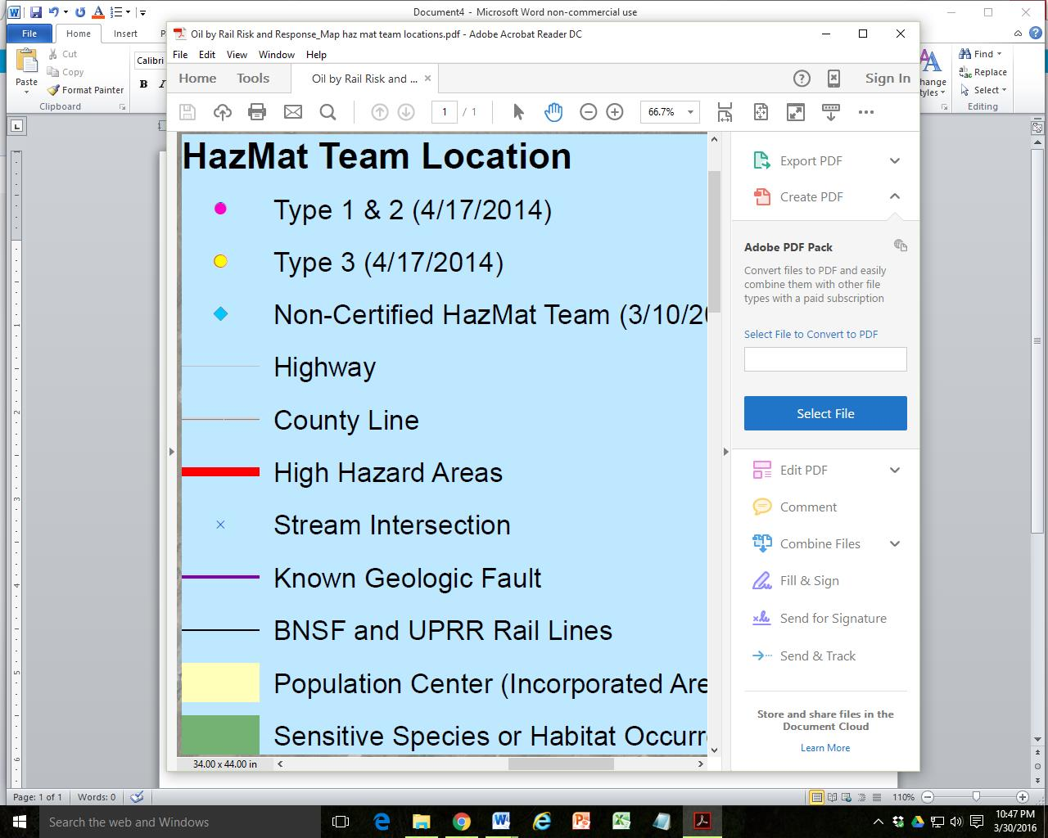

Slide 11
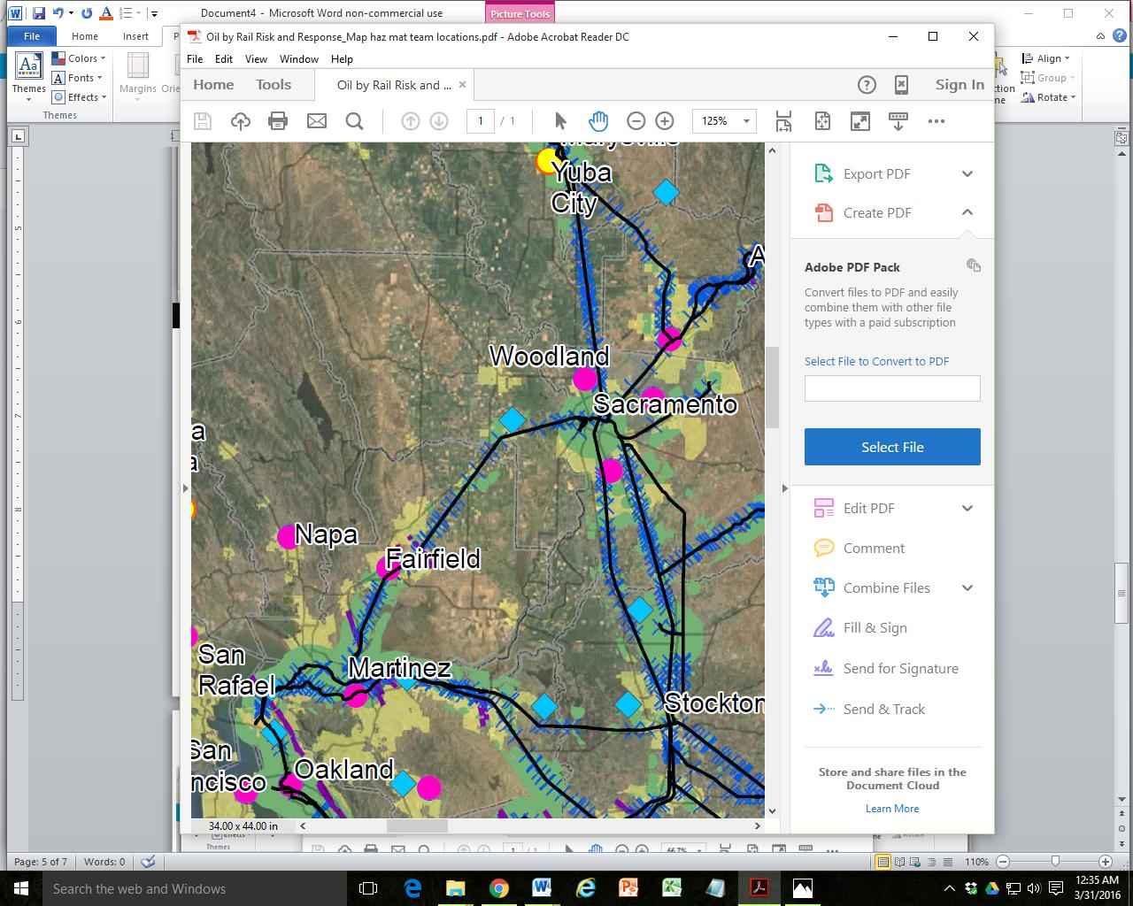

Slide 12
Regional Concerns for oil trains from Roseville to Benicia
Trains run right through neighborhoods & downtowns, even threatening the Capitol.
Tracks run beside and cross over critical water supplies.
Trains run through sensitive species and habitat occurrence areas.
Known geologic faults run close to Benicia and the tracks.
Recent reports state that sea level is rising faster than predicted. The project is at sea level. What happens if the tracks flood?

